Slide 1
Word Sense Disambiguation
Marwah ALian

Slide 2
Word Sense Disambiguation
Word sense disambiguation or discrimination (WSD) is the task of classifying a token (in context) into one of several predefined classes .
WSD/WSI is considered one of the hardest tasks in artificial intelligence (AI).
Computationally determining which sense of a word is activated by its use in a particular context.
      E.g. I am going to withdraw money from the bank.

Slide 3
WSD requires
It often requires not only linguistic knowledge,
but also knowledge of the world (facts).
For example:
  we use world knowledge to decide that the intended sense of ‘bass’ in ‘they got a grilled bass’ is a fish, and not a musical instrument (since we know that typically one would grill fish, not instruments)

Slide 4
Philosophies for dealing with WSD
There are two main philosophies for dealing with WSD: deep approaches and shallow approaches;
Shallow approaches don't try to understand the text. They just consider the surrounding words. It depends on the rule of: "one sense per discourse" as a generalization for "one sense per collocation" rule; where words are syntagmatically related as they tend to appear together in same syntagma (sentence) .
This approach uses a training corpus of words tagged with their word senses. Actually, it gives better results in practice, but of course it can be confused by tricky sentences

Slide 5
Difficulty in Evaluation
Comparing and evaluating different WSD approaches is difficult because of the different training sets, test sets, and knowledge resources adopted.
WSD is very important in many Information Retrieval (IR) aspects: filtering results, better ranking, giving suggestions, and query expansion.
WSD affects the recall and precision of any text mining (TM) classifier.

Slide 6
WSD in Semitic Languages
WSD and WSI in Semitic languages such as Arabic have greater challenges than in English. This is due to the fact that :
(1) in many cases short vowels are only represented via diacritics that are often omitted in modern writing, and
(2) several frequent prepositions, and many types of pronouns (e.g., possessive or prepositional pronouns) are expressed as agglutinated affixes.
Hence the biggest challenge for Semitic language semantic processing for WSD is determining the appropriate unit of meaning that is relevant for WSD/WSI

Slide 7
WSD Approaches
Knowledge Based Approaches
  WSD using Selectional Preferences (or restrictions)
  Overlap Based Approaches
Machine Learning Based Approaches
  Supervised Approaches
  Semi-supervised Algorithms
  Unsupervised Algorithms
Hybrid Approaches
7

Slide 8
WSD Approaches
Knowledge Based Approaches
  Rely on knowledge resources like WordNet, Thesaurus etc.
  May use grammar rules for disambiguation.
  May use hand coded rules for disambiguation.
Machine Learning Based Approaches
  Rely on corpus evidence.
  Train a model using tagged or untagged corpus.
  Probabilistic/Statistical models.
Hybrid Approaches
    Use corpus evidence as well as semantic relations form WordNet.

Slide 9
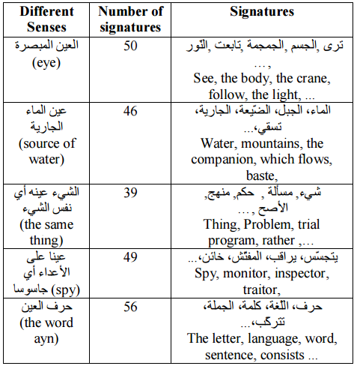
Example of signatures describing the possible meanings of the word “عین”

Slide 10
Arabic Word Sense Disambiguation researches:
A Semi-Supervised Method for Arabic Word Sense Disambiguation Using a Weighted Directed Graph,Laroussi Merhbene,Anis Zouaghi, Mounir Zrigui,2013
Ambiguous Arabic Words Disambiguation: The results, Laroussi Merhbene,Anis Zouaghi, Mounir Zrigui,2009
A Hybrid Approach for Arabic Word Sense Disambiguation, ANIS ZOUAGHI,2012
Using Fuzzifiers to Solve Word Sense Ambiguation in Arabic Language, Madeeh Nayer El-Gedawy, 2013

Slide 11
Summary
WSD is :
one of the central challenges in NLP.
Ubiquitous across all languages.
Needed in:
  Machine Translation: For correct lexical choice.
  Information Retrieval: Resolving ambiguity in queries.
  Information Extraction: For accurate analysis of text.
Computationally determining which sense of a word is activated by its use in a particular context.
      E.g. I am going to withdraw money from the bank.
A classification problem:
      Senses → Classes
      Context → Evidence
One issue with all the work on Arabic WSD is the problem of researchers not using a standard data set to allow for benchmarking.

Slide 12
References
Madeeh Nayer El-Gedawy, “Using Fuzzifiers to Solve Word Sense Ambiguation in Arabic Language”, 2013.
ImedZitouni, “Natural Language Processing of Semitic Languages”, Springer, 2014
Laroussi Merhbene,Anis Zouaghi, Mounir Zrigui, Ambiguous Arabic Words Disambiguation: The results, 2009 .

