Slide 1
Deep Learning Based Technique for Plagiarism Detection in Arabic Texts
Dima Suleiman, Arafat Awajan and Nailah Al-Madi
The International Conference on new Trends in Computing Sciences (ICTCS2017)

Slide 2
About the Presenter
Dima Suleiman
Education:
  PhD. Computer Science, Deep Learning, NLP (2015-)
  MSc. Computer Science (2002-2004)
  BSc. Computer Science(1998-2002)
Contact:
  Dima.suleiman@ju.edu.jo
  Dimah_1999@yahoo.com

Slide 3
Agenda
Introduction
Word2vec Applications
Related Works
Contribution
Background(word2vec)
Arabic Language Features
Experiments and Results
Conclusion and Future Work

Slide 4
Introduction
Plagiarism detection is one of the active research topics in Natural Language Processing (NLP). It aims to detect the reusing, reproducing and/or changing the text from one form to another one.
Plagiarism detection is very important especially for researchers and students.
Although, there are many plagiarism detection tools, it is still challenging task because of huge amount of online documents.
In this research, we propose to use word2vec model to detect the semantic similarity between words in Arabic language which can help in detecting plagiarism.

Slide 5
Word2vec Applications
Word2vec was used in many applications of English language, such as:
  Bilingual machine translation between English and Spanish[1].
  Part of Speech Tagging (POST) for eight languages where one of them was Arabic Language [2].
  It was used in keywords extraction where the extraction of keywords is realized without any prior knowledge about the document domain[3].

Slide 6
Word2vec Applications
Furthermore, word2vec was used in Arabic language processing:
  Name Entity Recognition system[4].
  Sentiment classifiers [5].
  Morphological analyzer for Arabic, English and other languages since this process depends on vector space[6]

Slide 7
Related Works
Word2vec was used in Persian plagiarism detection, where the words are represented using vectors *. However, it is not used in Arabic plagiarism detection
The performance of plagiarism tools for Arabic text still very week or inexistent.
Existing methods depend mainly on using paraphrase detection and matching of keywords on small dataset.
Gharavi E., Bijari K., Zahirnia K., Veisi H., A Deep Learning Approach to Persian Plagiarism Detection, FIRE (Working Notes) 2016: 154-159

Slide 8
Contribution
In this work, the word2vec model is used in order to find the features of vectors of words, and to use these features to compute the contextual similarity between words.
To increase the performance of this model, large corpus will be used for training the model.

Slide 9
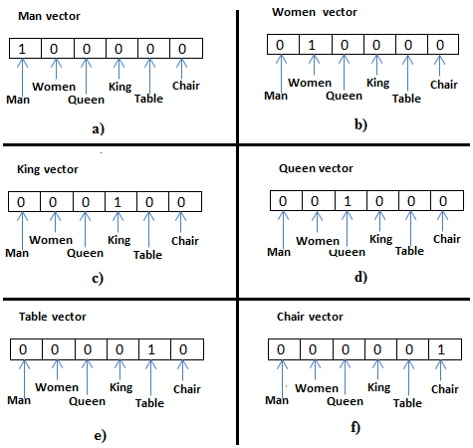
Background (Word Vector Representations)
If we have 6 vocabularies then we must have 6 vectors and the size of each one is 6
Converting a word into vector is one of the most important ideas to deal with NLP problems.
In vector representation the dimensions of the vector equal to vocabulary size.
One of vector representation is called “one hot” representation.
There are two problems:
Sparse spaces(curse of dimensionality)
Difficulty of computing similarity between two words from their vectors.
Figure 1 - One-hot representation of six words: Man, Woman, Queen, King, Table and Chair
Notes:
sematic

Slide 10
Background (Word2vec)
Word vector representation can be computed by applying neural network on very large dataset.
Mikolov and his colleagues proposed what is called word2vec which consists of two models*:
  Continuous Bag-of-Words Model (CBOW) and
  Continuous Skip-gram Model (Skip-gram)
*Mikolov, T., Chen, K., Corrado, G., & Dean, J. (2013). Efficient estimation of word representations in vector space. In ICLR.

Slide 11
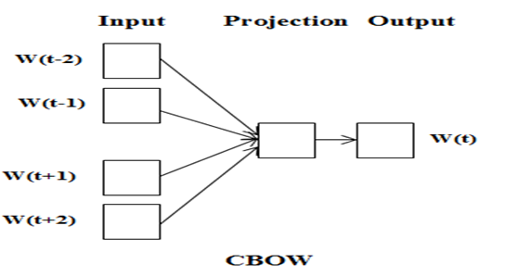
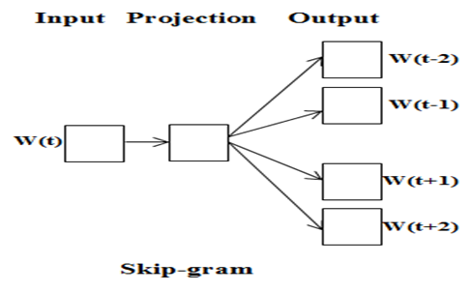
Background (Word2vec)
In both models, sliding window is used with size n, in this example n = 5.
window keeps sliding over the whole corpus recursively
Continuous Bag-of-Words model (CBOW), which predicts the current word depending on neighboring words
Continuous Skip-gram model (Skip-gram) where the current word is the input and the model predicts the surrounding words.
Figure 2 - CBOW and Skip-gram models architecture[Mikolov, T., Chen, K., Corrado, G., & Dean, J. (2013).

Slide 12
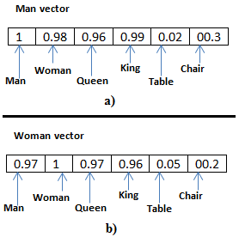
Background (Word2vec)
Feature of Vectors of “Man” and “Woman” words after using word2vec shown in Figure 3
The weight between “Man” and “Woman” is high
The weight between “Man” and “Table” is low
Figure 3 - Distributed representation of two words: Man, Woman

Slide 13
Background (Word2vec)
Representing words as vectors simplifies performing algebraic operations such as addition and subtraction of two vectors.
For example the result of
  vector (“Queen”) – vector (“Woman”) + vector (“king”)
will be close to the vector representation for “Man”*.
Weights are very sensitive to:
    Corpus quality
    Semantic and Syntactic relationship between words
*T. Mikolov, W.T. Yih, G. Zweig. Linguistic Regularities in Continuous Space Word Representations. NAACL HLT 2013

Slide 14
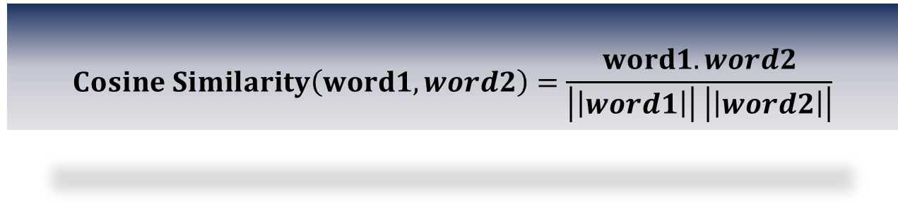
Background (Word2vec)
On the other hand the similarity between vectors were computed by using cosine similarity
$$Cosine Similarity\left(word1,word2\right)=\frac{word1.word2}{\left|\left|word1\right|\right| \left|\left|word2\right|\right|}$$

Slide 15
Arabic Language Features
Arabic language is full of morphology that can be divided into concatenative and templatic.
Concatenative morpheme consist of stem in addition to affixes and clitics.
  There are three types of Affixes : prefix, circumfixes and suffix.
      prefixes are zero or up to four characters that may precede the stem
      suffixes are zero, one, two or three characters that may follow the stem
      circumfixes which combine both prefixes and suffixes

Slide 16
Arabic Language Features
There are two types of clitics : proclitics and enclitics.
  proclitics occur at the beginning of the word
  enclitics occur at the end of the word
The general representation of concatenative morphemes can be as follows where character [] indicates optional morpheme:
[Proclitic(s)+[Prefix(es)]] + stem + [Suffix(es) + [Enclitic]].
Morphemes of the word “وسيكتبونها”,which means “and they will write it,” read in transliteration as “wa-sa-ya-ktub-uwna-hA”*.
*Habash, N., Soudi, A., and Buckwalter, T. 2007. On Arabic transliteration. In Arabic Computational Morphology. Springer. 15–22.

Slide 17
Arabic Language Features
Most of words in Arabic language are generated using Templatic morpheme or root-and-pattern scheme(derivative).
The word can be derived by applying the morphological pattern on the root or stem, where morphological patterns or balances are already listed and predefined.
Accordingly, ten of words (surface form) can be generated from one root. The number of words having three letters long root is around 5,000 which is the most common root length*.
*Beesley, R. 1996. Arabic finite-state morphological analysis and generation. In Proceedings of the 16th International Conference on Computational Linguistics (COLING’96). 89–94.

Slide 18
Experiments and Results
Dataset:
In our experiments we used publicly available OSAC Arabic corpus which consists of 22,429 text documents*.
The text documents in OSAC were divided into ten categories:
      Health, Astronomy, Entertainments, Low, Education & Family, History, Sports, Stories, Religious and Fatwas Economics, and Cooking Recipes.
The corpus was collected from different websites, and the number of words in corpus is 18,183,511 (18M) words.
*Saad M., Ashour W., OSAC: Open Source Arabic Corpora, Published at the 6th International Conference on Electrical and Computer Systems (EECS’10), Nov 25-26, 2010, Lefke, North Cyprus

Slide 19
Experiments and Results
Training the model
The whole corpus
Testing the model
Documents from the corpus
The documents that we used for testing was processed and the preprocessing that was made is stop words removal. Sample of the text after removing stop words can be shown in Figure 4.
كشف دراسة طبية بريطانية الأسبرين يعتبر خطورة يعتقد سابقاً الأخص بالنسبة لكبار السن توصلت الدراسة عقار الأسبرين يساعد الحد الإصابة السكتات القلبية الجلطات الدماغية وراء حالات النزيف المرضى الأخص معدة
Figure 4- Original Text

Slide 20
Experiments and Results
Word2vec has many parameters that can affect the results
Parameters | Value
Word2vec model | CBOW
Sliding window-size | 10
Dimensions for each vector | 100
Epochs value | 10

Slide 21
Experiments and Results
For example we replaced the verb “يعتبر” with the verb “يشكل”, and since the two wards have the same meaning the similarity between the two sentences is still very high with 99%.
Many changes were made replacing verb with another one where either they having the same meaning or having different meaning.
However when replacing the verb “يعتبر” with the verb “يأكل” the similarity become less since the two words have different meanings.
Cosine Similarity | New Text | Original Text
99.99% | يشكل | يعتبر
97.82% | يأكل | يعتبر
يشكل
يعتبر
يأكل
يعتبر

Slide 22
Experiments and Results
Also we tried to change the order of the words such as using “verb, subject, object” instead of “subject, verb, object” and vice versa.
For example “كشف دراسة طبية”, “دراسة طبية كشف” here we end up with 100% similarity since the meaning
remained the same
Cosine Similarity | New Text | Original Text
100% | دراسة طبية كشف | كشف دراسة طبية

Slide 23
Experiments and Results
“عكس معروف الأسبرين يساعد الحد الاصابة السكتات القلبية تبين سبب خطورة حسب دراسة بريطانية”
Good rephrasing, less similarity and less plagiarism.
Finally we tried to compare the original sentence with completely different one
“الجو جميل مناسب رحلات” and we got 12% similarity
Cosine Similarity | New Text | Original Text
42.33 % | عكس معروف الأسبرين يساعد الحد الاصابة السكتات القلبية تبين سبب خطورة حسب دراسة بريطانية | الجملة الاصلية
12.41% | الجو جميل مناسب رحلات | الجملة الاصلية

Slide 24
Conclusion
Our proposed technique is able to detect similarity between text using Word2vec.
This model was trained using large corpus.
The cosine similarity between the vectors was used to detect plagiarism. In this case the similarity between vectors is contextual similarity .

Slide 25
Future Work
Improve the quality of the corpus or to generate new one.
Make comparisons with other existing algorithms such as Turnitin.
Used different evaluation metrics such as precision and recall.
Tune the parameter of word2Vec.
Use several documents in testing.

Slide 26
Questions?
Thank You

Slide 27
references
[1] T. Mikolov, V. Le Q., Sutskever I., Exploiting Similarities among Languages for Machine Translation, arXiv:1309.4168v1 [cs.CL] 17 Sep 2013.
[2] Lin C., Ammar W., Levin C., Unsupervised POS Induction withWord Embeddings, Human Language Technologies: The 2015 Annual
Conference of the North American Chapter of the ACL, pages 1311–1316,Denver, Colorado, May 31 – June 5, 2015.
[3]Jiang B., Xun E., Qi J., A Domain Independent Approach for Extracting Terms from Research Papers, Springer International Publishing
Switzerland 2015 M.A. Sharaf et al. (Eds.): ADC 2015, LNCS 9093, pp. 155–166, 2015. DOI: 10.1007/978-3-319-19548-3.
[4] Zirikly A., Diab M., Named Entity Recognition for Arabic Social Media, Proceedings of NAACL-HLT 2015, pages 176–185,Denver, Colorado,
May 31 – June 5, 2015.
[5]Dahou A., Xiong S., Zhou J., Haddoud M., Duan P., Word Embeddings and Convolutional Neural Network for Arabic Sentiment Classification, Proceedings
of COLING 2016, the 26th International Conference on Computational Linguistics: Technical Papers, pages 2418–2427, Osaka, Japan, December 11-17
2016.
[6]Soricut R., Och F., Unsupervised Morphology Induction Using Word Embeddings, Human Language Technologies: The 2015 Annual

