Slide 1
Arabic Tagsets- Review
Marwah Alian
Arafat Awajan
Princess Sumaya University for Technology

Slide 2


What is a Tagset?
A tagset is a set of tags (symbols) representing information about parts of speech and about values of grammatical categories (case, gender, etc.) of word forms.
A tagset is the basis of almost all NLP fields.
A good tagset is very important in the fields of NLP and it is the foundation stone in these fields.
simplicity of the POS tagset is intended to speed up human annotation and maintain the most important distinctions.

Slide 3
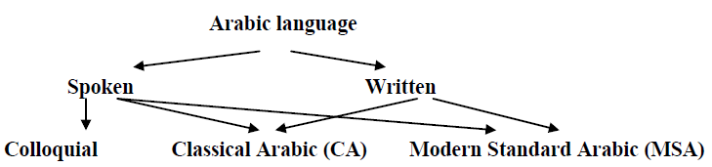



Arabic Language Categories
Classical Arabic (CA)
Modern Standard Arabic (MSA)
In Classical Arabic words have diacritical marks which solve the ambiguity in the language.
CA has less ambiguity than MSA.
Modern Standard Arabic is the written language of contemporary literature, journalism, most of books, etc.
MSA is a descendant of CA and retains the basic syntactic
MSA is highly ambiguous which results from removing diacritical marks from writing.

Slide 4
Tagsets and NLP community
Tagsets received a lot of intention of NLP community.
In general they are well defined and implemented for English and Europe Languages.
In the case of Arabic Language, a lot of tagsets are proposed but till now there is no well defined tagset and recognized by the community of NLP.

Slide 5



Main Tagsets for Arabic
2000-2004
El-Kareh and Al-Ansary
Khoja
Buckwalter
Reduced Buckwalter tagsets BIES
The Extended Reduced TagSet (ERTS)
Penn Treebank: PATB
2006-2009
Alshamsi and Guessom
ARBTAGS
CATiB
Yahya Elhadj
2010-2013
Salma
Aliwy

Slide 6
El-Kareh and Al-Ansary (2000)
Description
Limitations
- many of Arabic classes are not taken into account.
-words are classified into three main classes, Verbs, Noun and Particle. Each class is divided into subclasses, Verbs into 3 subclasses; Nouns into 46 subclasses and Particles into 23 subclasses..

Slide 7
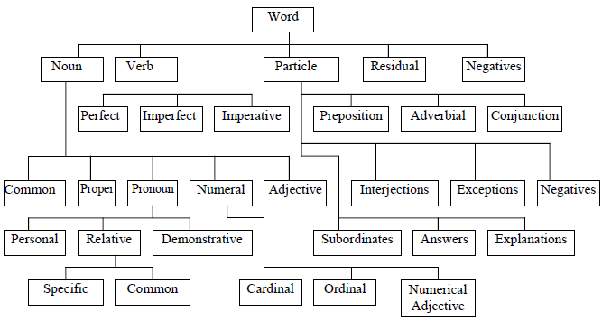
Khoja Tagset (2001)
Description
depends on ancient Arabic grammar to design a morphosyntactic tagset and she did not follow indo-European tagsets which depend on Latin.
All subcategories in Khoja tag set are derived from the parent categories therefore the tagset hold language generalization.
It has 177 tags.

Slide 8
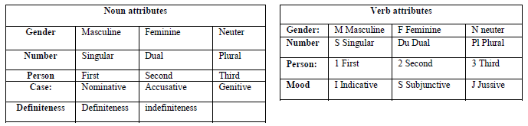
Khoja Tagset (2001)
Limitations
The attribute “person” in noun class is a mistake here because the word كتاب” “ book has no person
Particles have no attributes.
It is a very simple tagset, but many of Arabic classes are not taken into account.

Slide 9
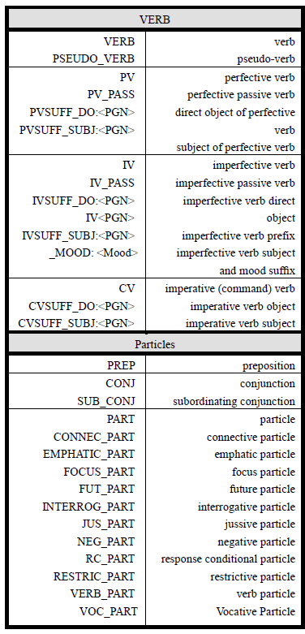
Buckwalter Tagset (2002)
Description
It is considered very rich for many computational problems and approaches.
Several tagsets have been developed that reduce it to a “manageable” size.
485 tags- untokenized
Thousands – tokenized

Slide 10
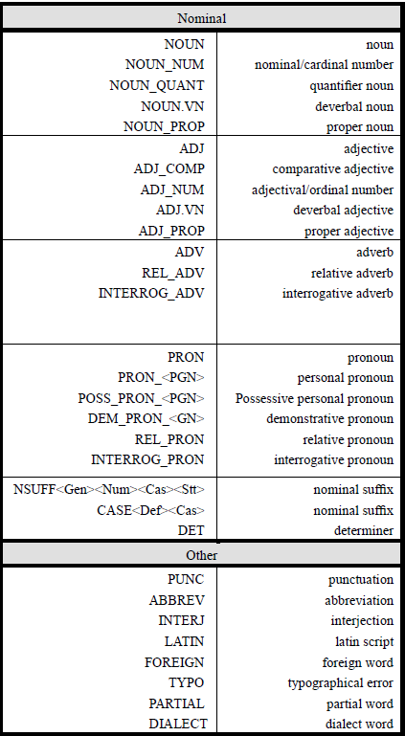
Buckwalter Tagset (2002)
Limitations
There is no distinction between categories and features for POS.
The particle classification has no attributes.
It does not distinguish between attached pronouns or other clitics and inflection of the word (suffixes).

Slide 11
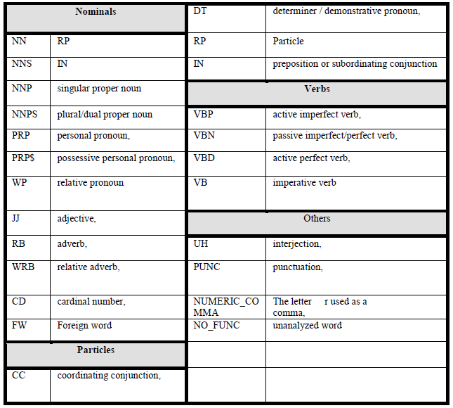
Reduced Buckwalter Tagset – BIES (2004)
Description
It has around 24 tags variants.
It was inspired by the Penn English Treebank POS tagset.

Slide 12
Reduced Buckwalter Tagset – BIES (2004)
Limitations
It is a very simple set which misses many useful features, in particular many classes of nouns, verbs and particles.
The nouns, verbs and particles have no attributes.

Slide 13
Extended Reduced Buckwalter Tagset (2004)
Description
ERTS is the base tagset used in the Amira system.
It has 72 tags.
It is a subset of the full Buckwalter morphological set defined over tokenized text.
Used in Amira system
Added the explicit or marked morphological features of gender, number and definiteness on nominal.

Slide 14
Alshamsi and Guessom Tagset (2006)
Description and Limitations
-Specific for Name Entity
-take into account the structure
of Arabic sentence
It has 55 tags
Limited for Name Entity. Many classes are not taken into consideration.

Slide 15
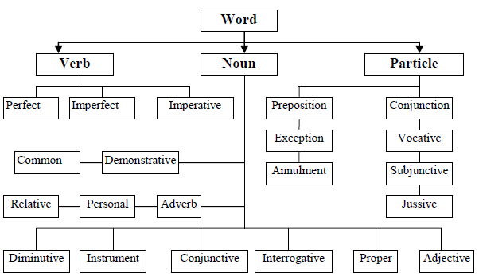
ARBTAGS [Al-Qrainy] Tagset (2008)
Description
Based on ancient Arabic grammar.
- 101 nouns, 50 verbs, 9 particles, 1 punctuation
161 detailed tags and 28 general tags

Slide 16
ARBTAGS [Al-Qrainy] Tagset (2008)
Limitations
- The attribute “person” in noun class is a mistake here because the word book has no person.
- Particles have no attributes.
- punctuations and foreign words are not covered

Slide 17
Penn Arabic Treebank (PATBPATB Tagset (2009)
Description
Limitations
- With some kinds of words, the PATB morphology systematically fails to determine many of the contextual and lexical parameters
- Follows Arabic traditional grammer.
tags specify details about word morphology such as definiteness, number, case, person, voice, gender and mood.
2,000 tag types including combinations of 114 basic tags.

Slide 18
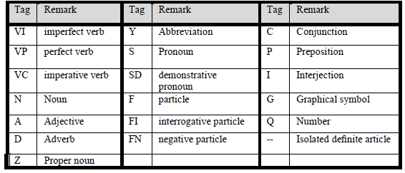
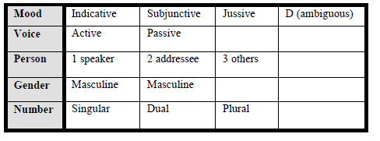
PADT Tagset
Description
- used in the ElixirFM analyzer, was developed for use in the Prague Arabic Dependency Treebank
- Each tag consists of two parts: POS and Features.

Slide 19
PADT Tagset
Limitations
It misses many classes and features.
Particles have no attributes.

Slide 20
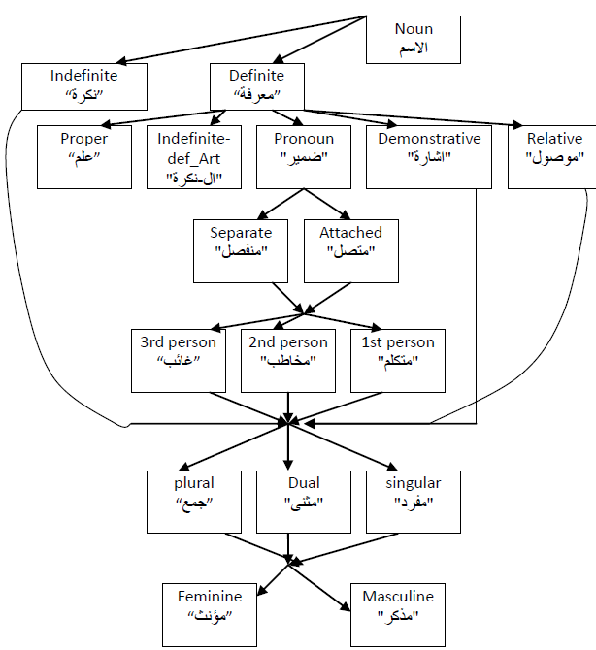
Elhadj Tagset (2009)
Description
It can be used for analyzing and annotating traditional Arabic texts, especially the Quran text.
The developed tagger employed an approach that combined morphological analysis with Hidden Markov Models (HMMs)
three classes (Noun, Verb, Particl).
.

Slide 21
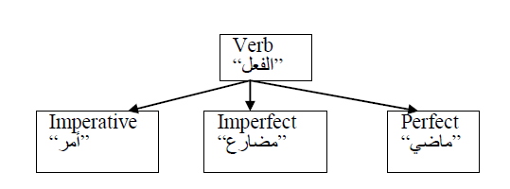
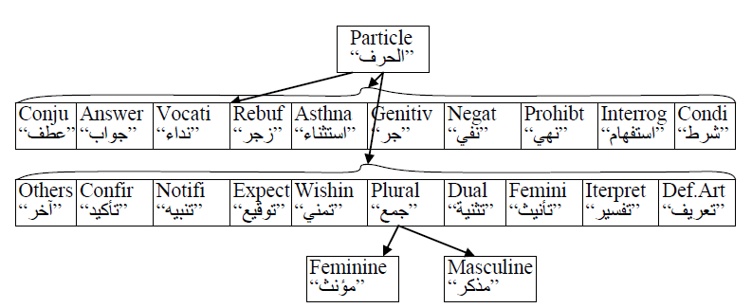
Elhadj Tagset (2009)
Limitations
particles have no attributes.
It is particularly simple with respect to verb and noun classifications.
The case of noun was excluded which is very important in syntax analyses.
It does not show any features for verbs and this is not a good choice, because Arabic verbs often have implicit pronouns and so on.

Slide 22
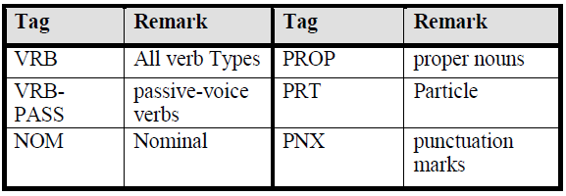
CATiB (2009)
Description and Limitations
There are only six POS tags in CATiB.
It is the simplest tagset where many classes and features are missed.

Slide 23
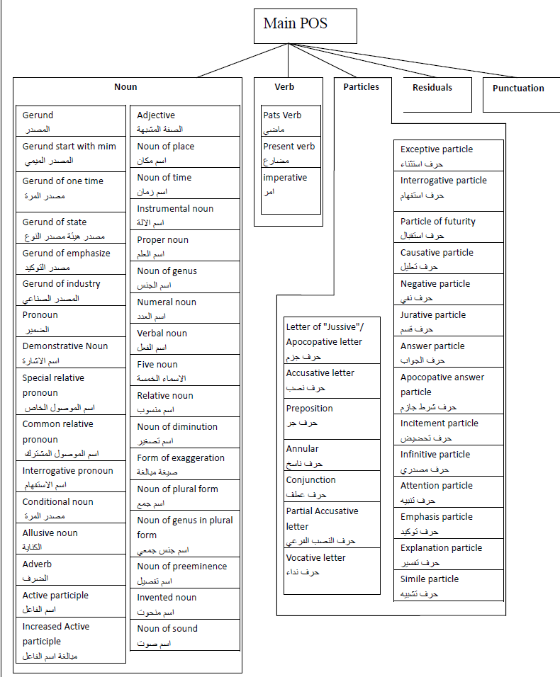
Sawalha Tagset
(Salma 2013)
Description
a tag consists of 22 characters; each position represents a feature and the letter at that location represents a value or attribute of the morphological feature; the dash “-” represents a feature not applicable to a given word.
Sawalha tagset is not tied to a specific tagging algorithm or theory, and other tagsets could be mapped onto this standard
.

Slide 24
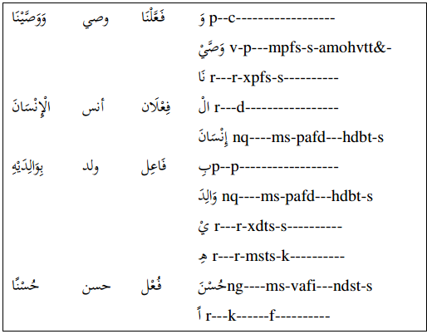
Sawalha Tagset
(2013)
Limitations
- This tagset neglects the variation of particles classification. Similarly as Khoja
- It does not distinguish between working and meaning of particles
- It is more theoretical than practical
- It summarizes almost all the Arabic classifications, especially for verbs and nouns. some of the classifications (attributes) are useless (redundant) tags, for tagging system.

Slide 25
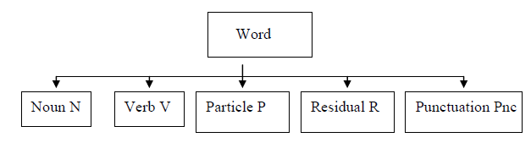
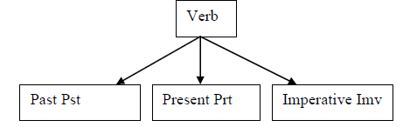
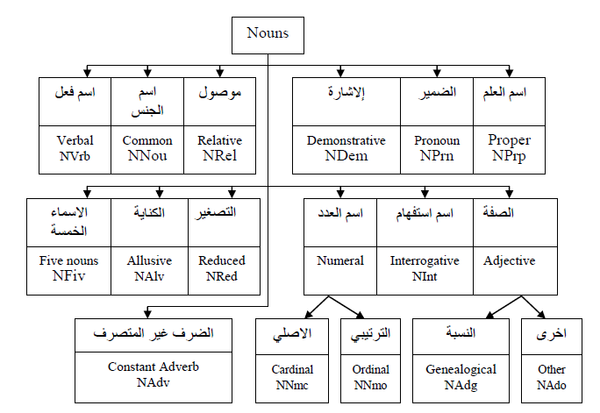
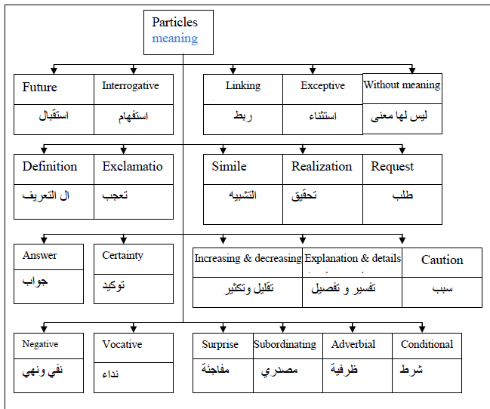
Aliwy Tagset (2013)
Description
The main tags in this tagset are Noun, Verb, Particle, Residual and Punctuation where Noun has 17 subclasses with the features: Number, Gender, Case and Structured.
Verb class has three subclasses: Past (Pst), Present (Prt), Imperative (Imv). While verb attributes are: Gender,Number,Person, Mood, Certainty, Structured, and Voice.
3552 detailed tags and 45 main tags

Slide 26
Conclusion
1
2
Marketing
Training
Assesment
3
Available Arabic tag sets do not have a standard scheme for correlating each word to its morpheme and they join the tagging of both morphemes and words.
Many reports about these tag sets do not give a detailed description for their design aspects.
The existing tag sets have a limitation in covering all the features of Arabic language which leads to missing features.

Slide 27
Conclusion
4
5
Marketing
Training
Assesment
6
A number of tagging systems involve a small number of tags that gives a narrow view about the text and they do not explain more about particles and verbs.
Even though the tag sets with large number of tags are complete and efficient for advanced tasks, they look very hard to be predicted while small tag sets tend to be more predictable and appropriate for many applications.
The analysis used for texts in designing existing tagsets do not cover all Arabic features and characteristics.

